Slide 1
Webinar –Stocktaking
March 2024
Notes:
Andrew

Slide 2
Stocktaking - overview
Important notes:
Always check and follow SOP’s
Always consider all stock points – especially important for multi sites
Before you start
Stock reports/valuation
Database backup
Consider:
Receiving orders
Things you may have processed but not packed
Repeats
Owings
Dosepacks and Cycles
Notes:
Mention multi-site considerations
Remind people to always check procedures especially when it comes to GCH.
What we are showing them today is only a guide and they should refer to their SOP in the first instance
Zeroing stock maybe necessary in those circumstances.

Slide 3
Preparation
When are you going to do your stocktake? (While open or after hours?)
How many people are needed?
How long will it take?
Are you zeroing stock first?
Multi-site?
Stock Value Report before stocktake
Corporate SOP's

Slide 4
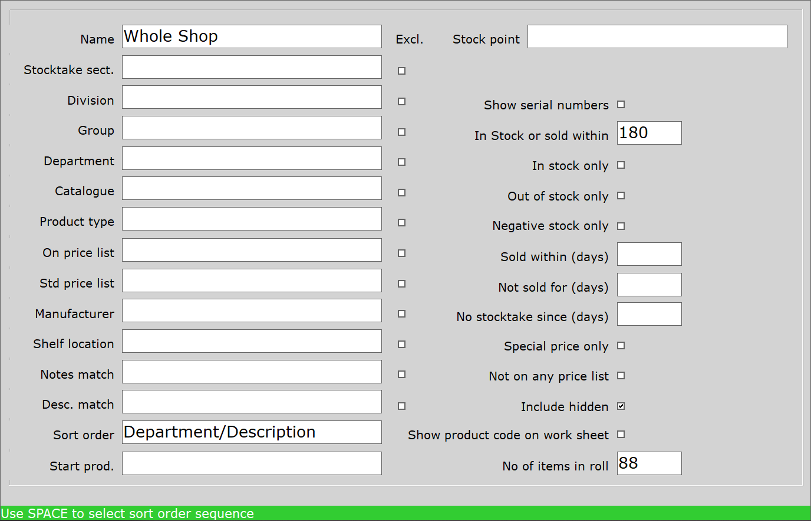
Rolling Stocktake
In Stock or sold within – 180 days includes seasonal items
Include Hidden
Items in roll
Sort order
Toni Article

Slide 5
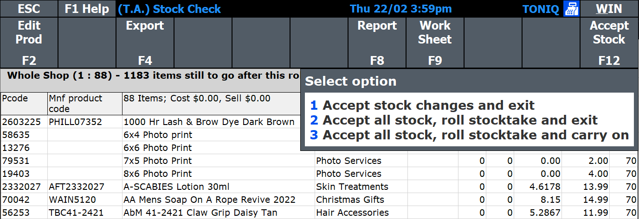
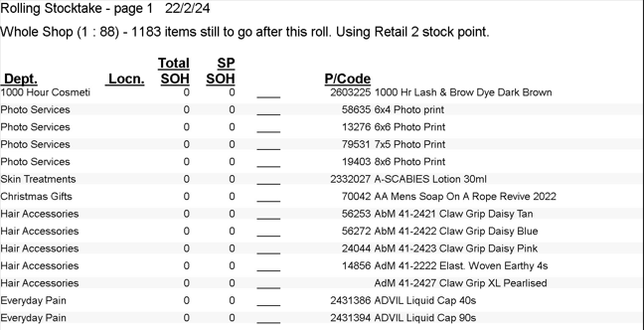
Rolling Stocktake
Finish for now, return to this screen when continuing
Finish for now, Move on to the next roll of products
Keep on stocktaking now

Slide 6
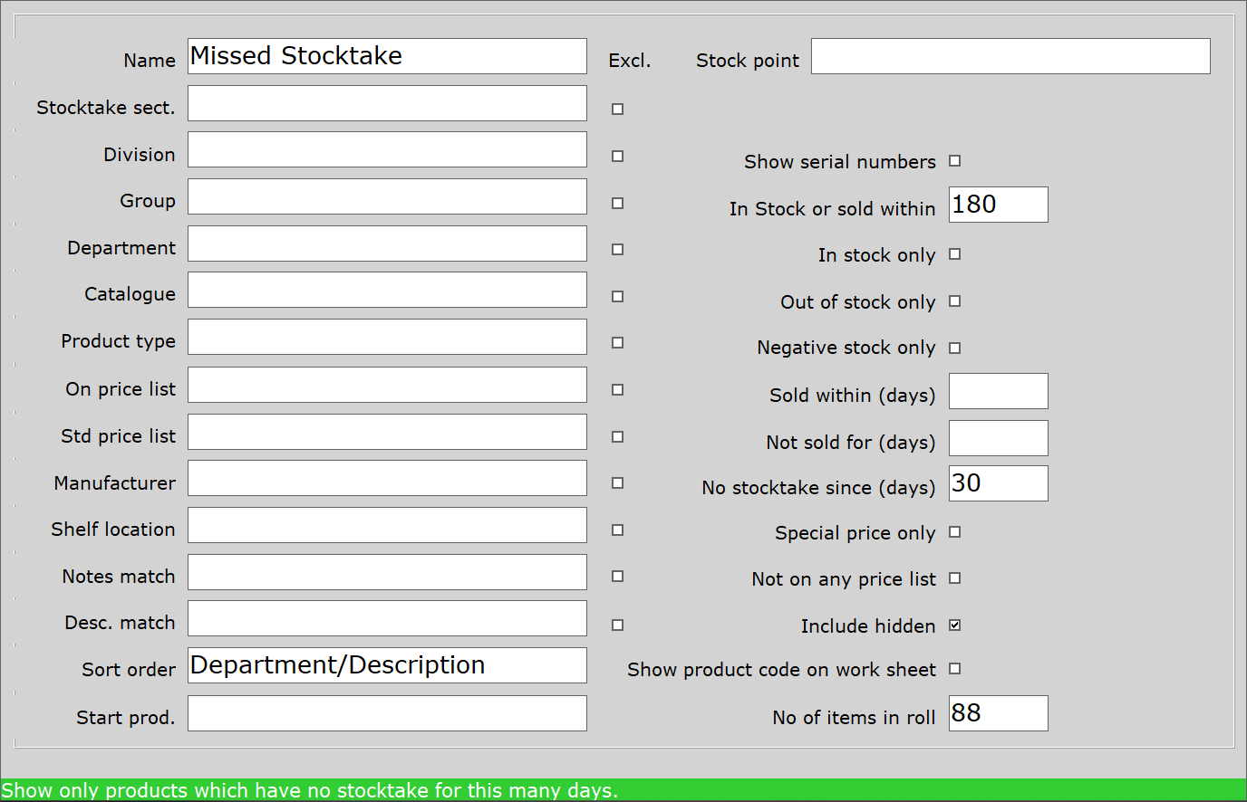
Missed items from Stocktake
In Stock or sold within – 180 days
No stocktake since (days) 30
Include Hidden
Items in roll
Sort order
Toni Article

Slide 7
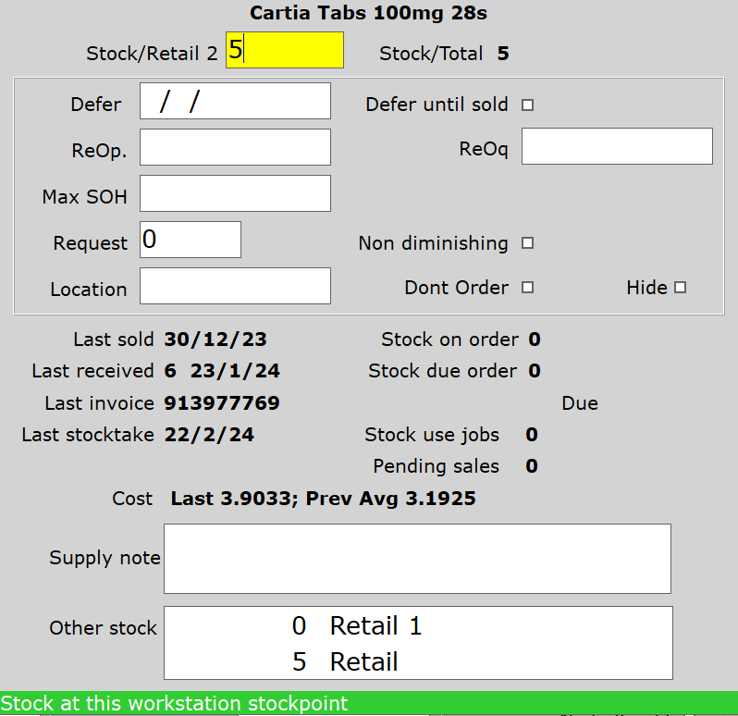
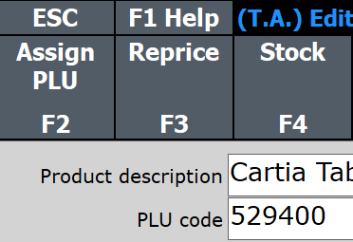
General Stocktake
General Stocktake for scanning random items
F4 Stock to change one item

Slide 8
Post Stocktake Reporting
Stock Value
Dead Stock
Negative Stock
High Stock
Buying multiples need fixing?

Slide 9
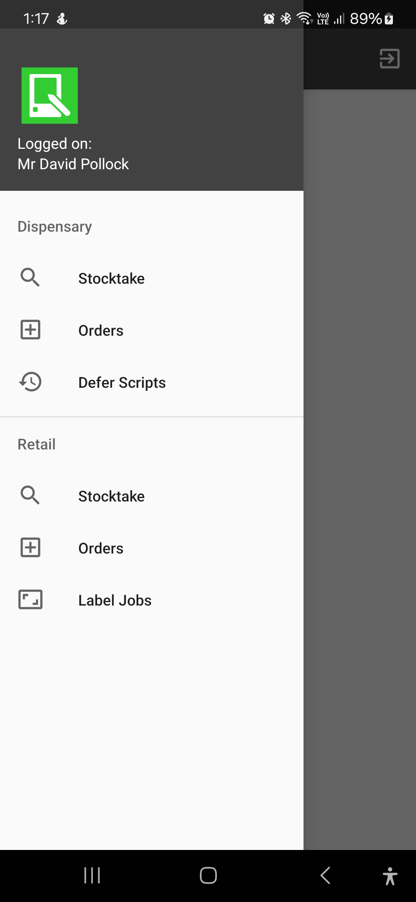
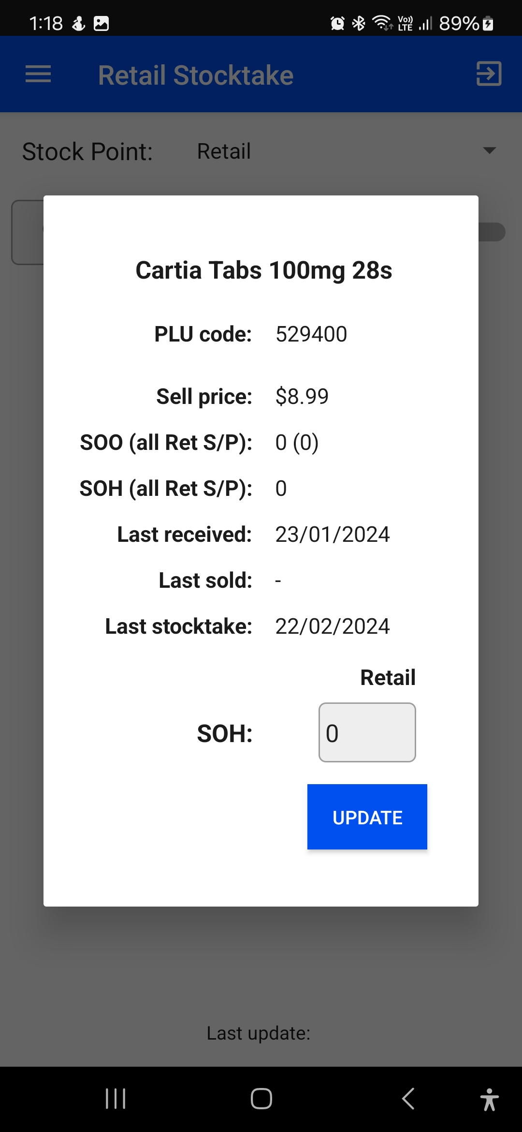
Toniq Mobile
Easy stocktaking through Android app
Can run on dedicated devices or phones with decent cameras
Notes:
\

Slide 10
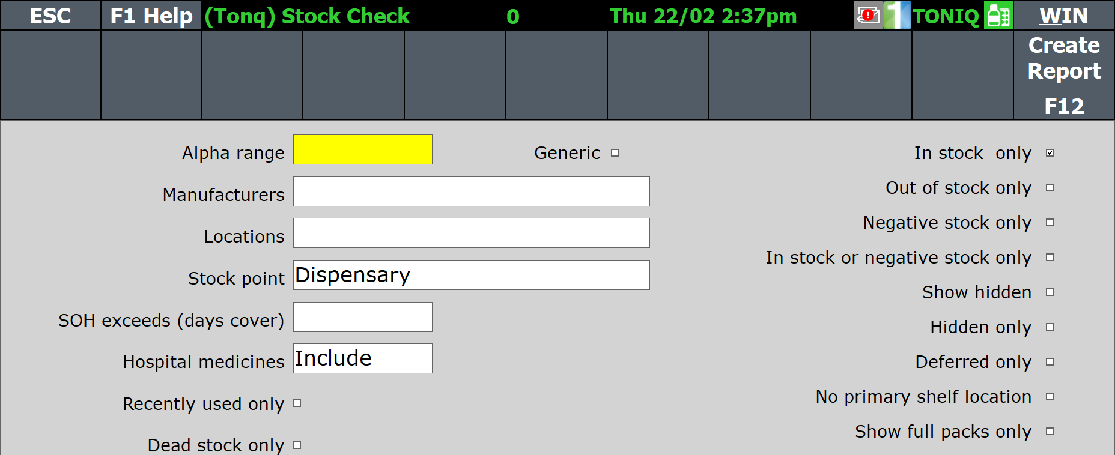
Dispensary - Stocktaking
Zeroing stock for stocktake
Which way to stocktake? Toniq Mobile, or Stock check.
What did I miss?
Stock Valuation

Slide 11
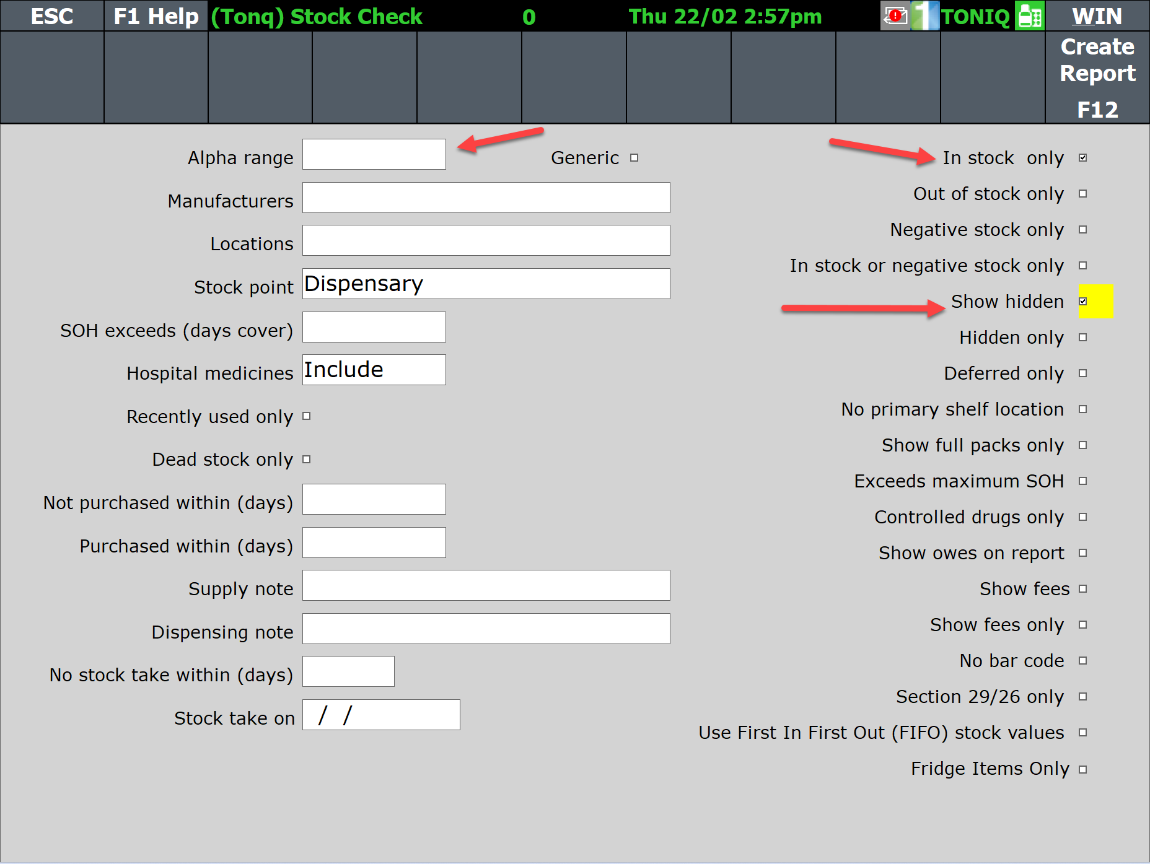
Dispensary – Stock Check
3. Reports
6. Stock reports
1. Stock check
Notes:
Stocktake End of Year Dispensary – Toniq (zendesk.com)
https://toniq.zendesk.com/hc/en-nz/articles/6732047379343-Stocktake-End-of-Year-Dispensary
Fifo
https://toniq.zendesk.com/hc/en-nz/articles/6732047621519-First-in-First-out-stock-valuation

Slide 12
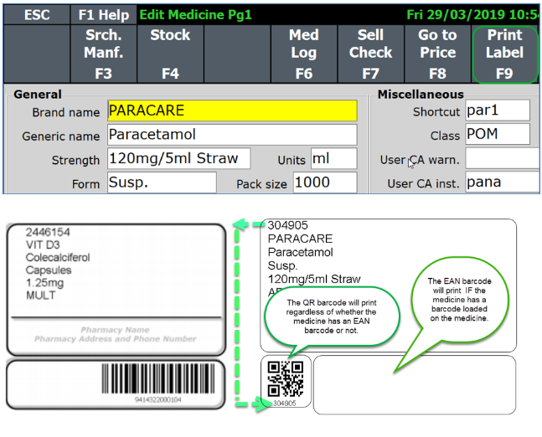
Dispensary Stocktaking - Barcodes
No barcode?
Notes:
Medicine Details Labels – Toniq (zendesk.com)
https://toniq.zendesk.com/hc/en-nz/articles/6732033941775-Medicine-Details-Labels

Slide 13
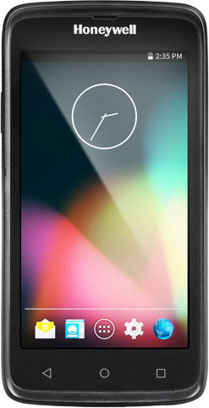
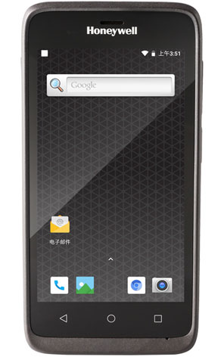
Toniq Mobile Special
Webinar special:
$100 (usually $300)
Monthly cost $15
Cancel at any time
Notes:
\

Slide 14
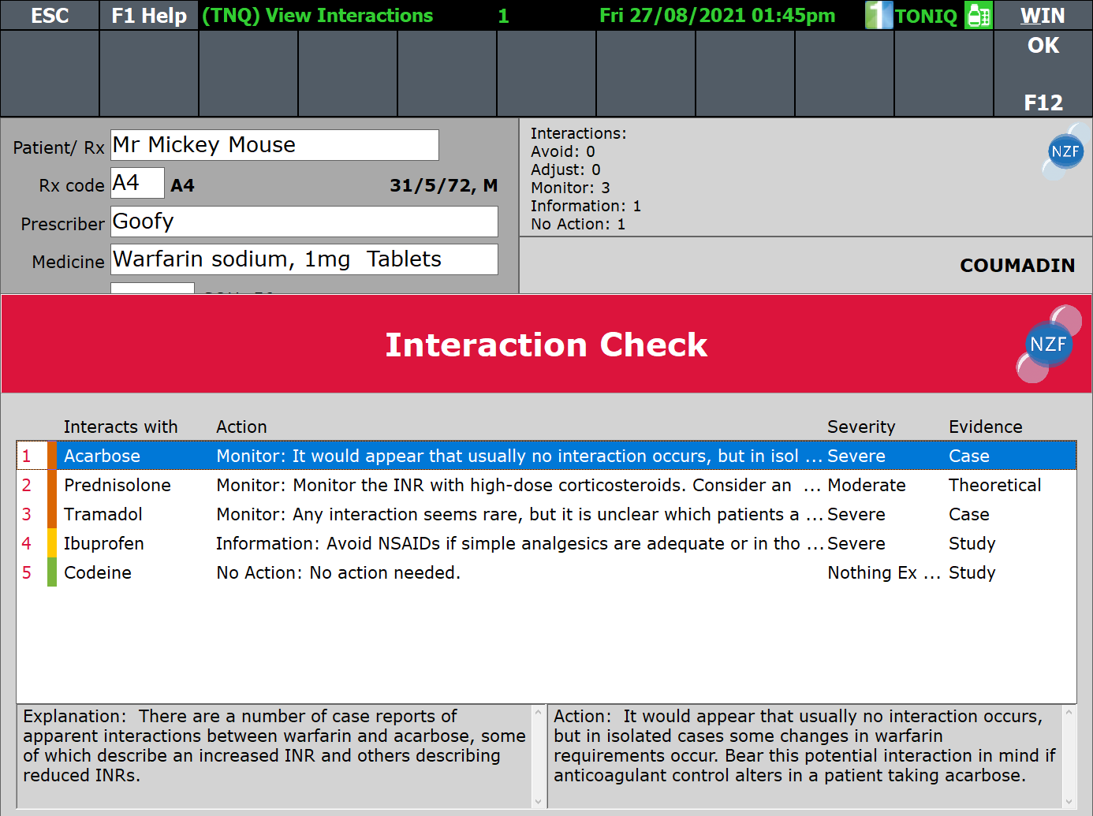
Still not using NZF?
Over half of pharmacies do!
Webinar special sign up today and receive 6 months free
Register now: https://toniq.nz/nzf/
Notes:
\

Slide 15
Toniq Help and Knowledge Base
Further information can be found in the Toniq Knowledge base:
toniq.nz/help
Questions?

Slide 16
Notes:
Andrew

